Slide 1
Holistic patrimonial investment:
How to combine and diversify investment strategies with a risk management and sustainable approach
Fernanda Salas
AFIR-ERM Florence Colloquium May, 2019

Slide 2
About the speaker
Fernanda Salas
Actuary, Faculty of Sciences, UNAM, Mexico
Part-time professor Finance, Risk Management and Demographics
Vice Chairwoman, AFIR-ERM Section , IAA
Member of CONAC (Mexican College of Actuaries)
Youngest member of the investments committee, VITALIS Asset Management
Actively participates in social causes getting involved in responsible investing

Slide 3
Disclaimer
The information given herein has been gathered from different sources and completed by Fernanda Salas, Vice Chairwoman of the AFIR-ERM Section of the IAA and member of the investments committee of VITALIS. The material in this presentation may include general background information about AFIR-ERM Section as well as of VITALIS current as at the date of this presentation. Such information is subject to change without notice and the IAA nor VITALIS is not under any duty to update this information nor responsible for it. The views and opinions expressed in the given presentation are those of the speaker and do not necessarily reflect the official policy or position of the IAA, the AFIR-ERM Section or VITALIS.

Slide 4
Overview
OPTIMAL ASSET ALLOCATION
INVESTMENT STRATEGIES AND RM
BEST EXECUTION

Slide 5
Optimal Asset Allocation
What is Optimal Asset Allocation?
It is a set of methods and techniques to achieve an investment objective (return) with the lowest risk possible.
The first step is to define the purpose of the investment, then start defining asset classes. It is also important to define liquidity needs.
Risk-return: We want to maximize returns with the lower risk possible. Options with higher risk will be suitable for investors who can accept strong fluctuations in value and with longer time horizons.
RETURN
Efficient frontier
High risk High return
Moderate risk Moderate return
Low risk Low return
Source: Own authorship
RISK

Slide 6
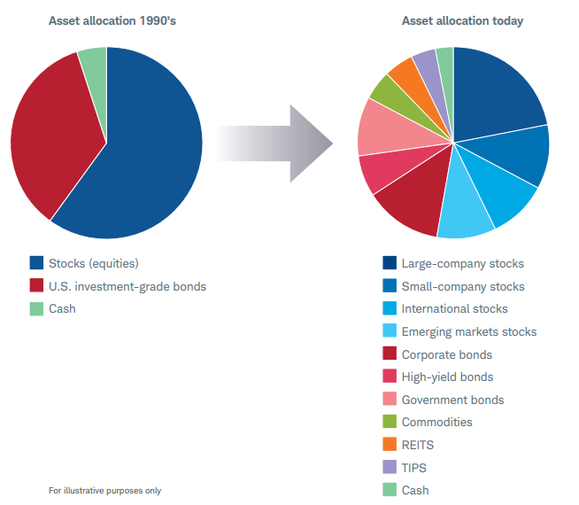
Investment products. Easy choice?
Source: Schwab Center for Financial Research

Slide 7
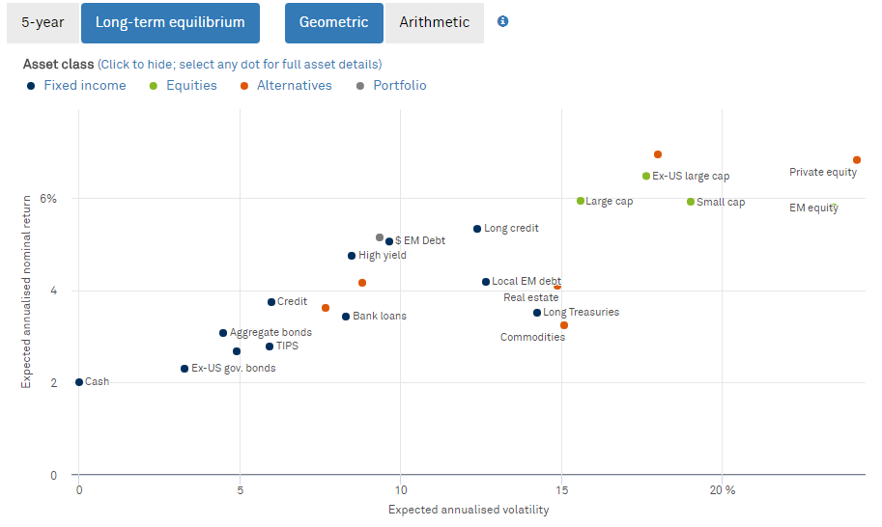
Choose your poison
Important to note: returns will vary depending on the period in time, but the covariance does not (at least not significantly).
Therefore it is wise to think in different possible scenarios.
Stress the scenario assuming different situations such as a big crisis, scenarios with low interest rates, high volatility...
Source: BlackRock

Slide 8
Markowitz (Efficient market portfolio)
Rationale: Risk-return equation
3 stages:
Efficient portfolios (and efficient frontier)
Risk aversion
Optimal portfolio
3 BIG assumptions:
Profitability is given by expected value
Risk is measured through simple volatility
Investors prefer higher return with lower risk
2 interpretations of optimal portfolio:
Given a target level return r_{p}, minimise risk
Given a target level of risk σ_{p} , maximise the return
RETURN (r)
Efficient frontier
r_{p}
p
Admissible portfolios
Minimum variance portfolio
σ_{p}
RISK (σ)
Source: Own authorship

Slide 9
Defining specific parameters for investment policy
Simulations
Despite the theoretical basis of Markowitz, it is recommended to carry out simulations under relevant scenarios in order to consider variables not assumed in the previous model:
Liquidity
Macro-economics
Geopolitics
Specific restrictions to countries/regions
Specific constraints to industries/sectors
ESG factors
Conflicts of interest…
Source: Geographic Sciences

Slide 10
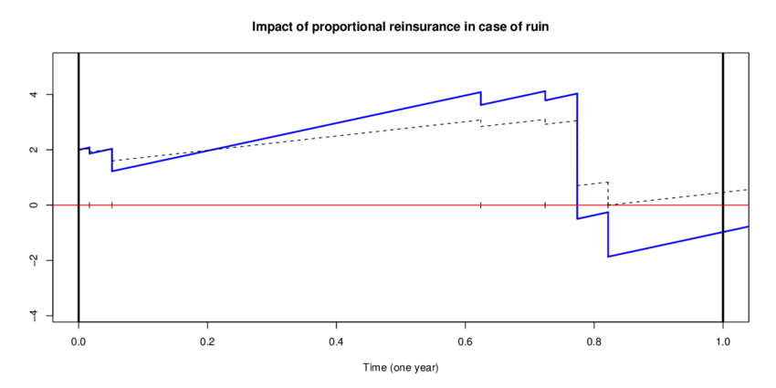
Stochastic models for Asset Allocation
ALM (Asset Liability Model): Seeks to “fit” today’s assets with future expected liabilities
Ruin probability: Defined as the probability of the value of the portfolio falling below a previously defined level under different scenarios
Black-Litterman: Given the initial investment, maximise expected utility, minimizing risk
Dynamic asset allocation: The composition of the portfolio is reviewed with high frequency and rebalanced according to market movements
Source: ResearchGate

Slide 11
Benchmarking
What is a Benchmark (BMK)?
A reference used to compare the risk and performance of a given portfolio
Common BMKs: indexes, ETFs or funds; both in broad categories (S&P 500, MSCI World) or as specific asset classes (T-Bills, "small-caps", EM, High Yield Bonds); or a combination of the previous
To define a BMK it is necessary to know the risk profile of the portfolio, and adapt it to the composition of the portfolio
"Living Benchmark" as another asset class (a “passive portfolio” that helps compare the portfolio while generating attractive low-cost returns)
Source: The Register

Slide 12
BMKs
Strategy: Global Equity portfolio (for Mexican clients)
BMK: 90% ACWI (MSCI World) + 10% Index Mexican Treasuries
Source: Own authorship
Strategy: EMB (global and local currency)
BMK: 40% EMB + 40% LEMB + 20% Index T-Bills (1-3y)
Source: Own authorship

Slide 13
Overview
OPTIMAL ASSET ALLOCATION
INVESTMENT STRATEGIES AND RM
BEST EXECUTION

Slide 14
Different asset management styles
Fundamental Analysis
Technical Analysis
Quant investing
Passive Investments
Minimun volatility
Smart Beta
Source: Own authorship

Slide 15
Geometric classification of funds
Capital Asset Pricing Model (CPM)
Is a linear regression of asset 𝑎 with respect to the market M
α = absolute return (fraction of the total return that cannot be explained by the market)
ꞵ =systematic risk (exposure to the market)
ℇ = idiosyncratic risk (eliminated via diversification)
Source: Labadie, Mauricio. Geometry of an investment portolio.

Slide 16
«Big Brother»
Analysis and monitoring of the strategies of other managers
Take care of the client’s interests and to know how is the portfolio in the overall; helps to have the “big picture”
Discuss their investment strategies and get involved in the daily monitoring of investments, to ensure acting in accordance with the client's risk profile
Demostrative example only

Slide 17
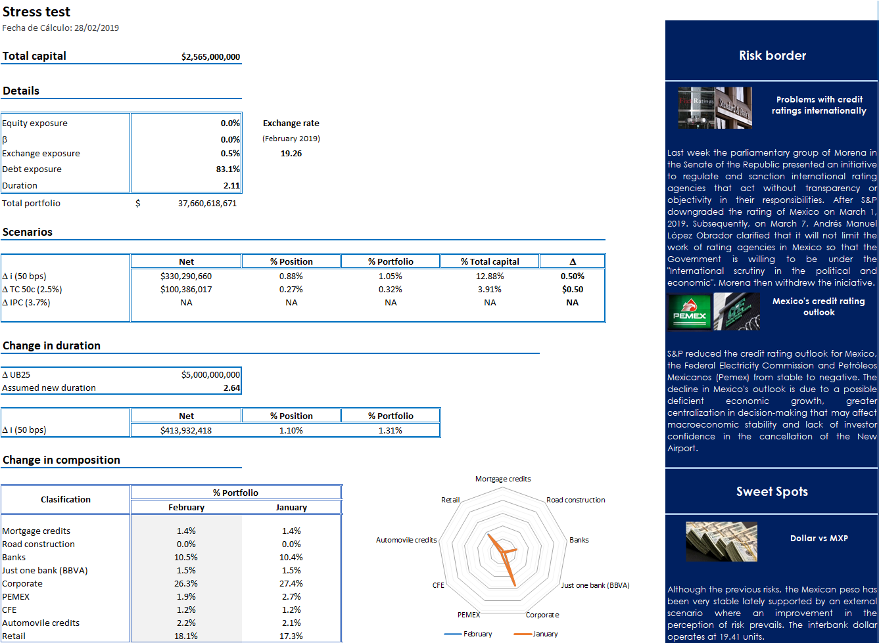
Demostrative example only

Slide 18
Risk Management
When the goal is to preserve and make money grow, it is vital to have a risk approach.
While there are direct mitigable risks (covered by market or exchange rate hedges); there are imputable risks such as the risk of concentration, credit and liquidity, which need a deeper analysis.
It is important to see a portfolio of risks, rather than one of just assets.
Source:own authorship

Slide 19
ESG factors with RM approach
ESG factors became popular
As a relevant factor for Risk Management analysis in investments, they have proven to be important triggers of downsides to some stocks and bonds, and with good reason
ESG factors provide a better understanding of the management, a screening of regulatory risks and a projection of future appreciation of investments
It is still difficult to “give a number” and quantify some of these factors

Slide 20
Overview
OPTIMAL ASSET ALLOCATION
INVESTMENT STRATEGIES AND RM
BEST EXECUTION

Slide 21
Best Execution
Short-term follow-up to long-term strategies
Keep updated in research and best practices
Multidisciplinary and independent talent
Diversify risks, do not underestimate being conservative
Only invest in assets in which you have enough knowledge of
Avoid any conflict of interest
“Keep it simple”
Transparency is key

Slide 22
THANK YOU!
Fernanda Salas fsalas@vitalis.com.mx

