Slide 1
ESG factors in investments for a better world
Héctor Islas
2019

Slide 2

About the author
Héctor Islas Terán
Actuary student at Faculty of Sciences UNAM (Mexico City)
Head of Research and Risk Management at VITALIS Asset Management.
Member of AFIR-ERM since 2017 and has been collaborating as a volunteer with the section board.

Slide 3
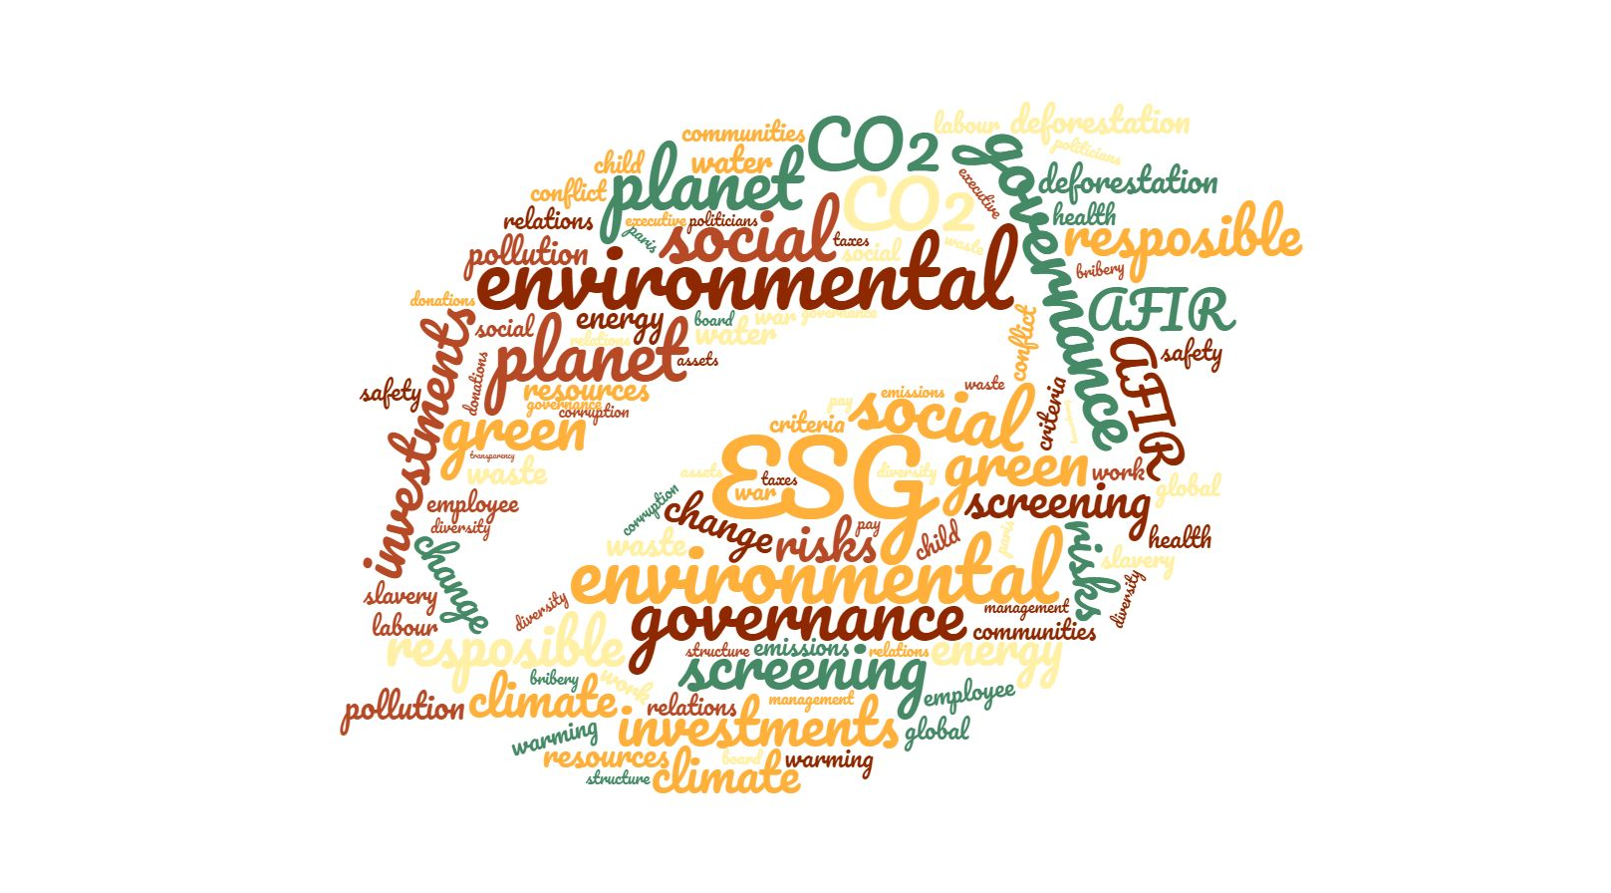
ESG (Environmental, Social, Governance)

Slide 4


ESG (Environmental, Social, Governance)
Responsible investment is an approach to investing that aims to incorporate environmental, social and governance (ESG) factors into investment decisions, to better manage risk and generate sustainable, long-term returns.
  Environmental
  Social
  Governance

Slide 5
Examples of ESG Issues
Environmental Issues
Social Issues
Governance Issues
  Land degradation
  Resource depletion
  Deforestation
  Biodiversity Loss
  Labour standards
  Human Capital Management
  Government and community relations
  Independent directors
  Disclosure and reporting
  Accounting treatment
  Succession planning
  Audit committe structure
  Environmental Protection
  Air and water pollution
  Waste Management
  Human rights
  Supply chain management
  Conflict regions
  Executive remuneration
  Corruption
  Shareholders rights
  Business ethics
  Board Composition
  ESG enrollment

Slide 6






Why should investors use ESG factors?
We are living complicated times and we are at a point of no return in which if we do no change to the way we live, we will end with the world as we know it.
Acceleration of Global changes
Demographic changes
Consumer behavior
Increase in regulation
Shortage of natural resources
Climate change
Save the world as an individual/organization
Competitive advantage
Better risk management
Encouraging companies to be better
Generate sustainable, long-term returns
….

Slide 7
How?
Own ESG analysis process
    Establish a checklist of ESG factors to be evaluated in each investment
    Rate risks / opportunities
    Each factor carries its weight, at the discretion of the analyst
    Obtain average score for comparison and historical follow-up (evolution)
    Use rating to impact discount rate
      At the analyst's discretion
      Clear breakdown
      Discussion in committee

Slide 8
ESG factors steps
Investable Universe
Portfolio Monitoring
Active
Ownership
Financial Screening
Fundamental Analysis
Portfolio Optimization
ESG Screening
ESG Analysis
ESG Optimization
ESG Monitoring
ESG engagement

Slide 9
ESG analytics
ENVIRONMENTAL
SOCIAL
GOVERNANCE
D A T A
Total greenhouse gas emissions
Total energy consumption
Total waste
Total environmental fines
Number of spills
Water intensity (eg water consumption per unit of measure such as EBITDA, assets or sales)
Greenhouse gas intensity
Energy intensity
Number of workplace safety violations
Number of community protests or incidents
Number and cost of product recalls
Percentage of women in workforce
Percentage of women in management
Lost time incident rate
Unionization rate
Employee turnover rate
Number of board meetings
Board meeting attendance
Number of audit committee meetings
Percentage of independent directors
Percentage of women on the board
Average CEO to worker pay
R A T I O S

Slide 10
Establish a checklist of ESG factors to be evaluated

Slide 11
Each factor carries its weight

Slide 12
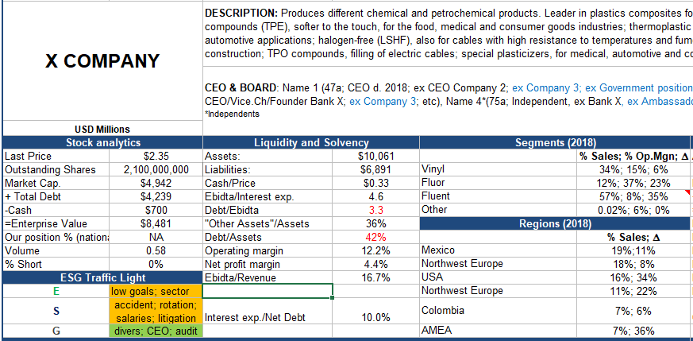
Traffic light system in the general analysis of the company

Slide 13
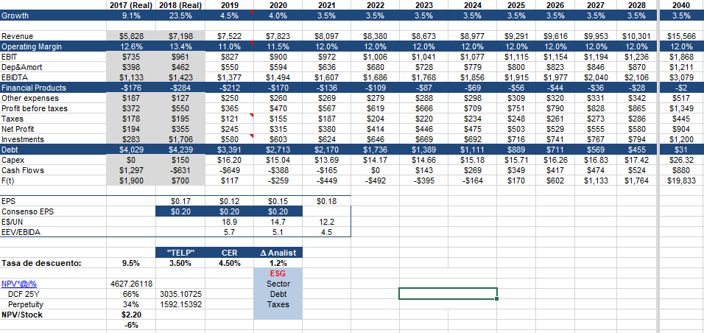
ESG ranking application to the discount rate

Slide 14
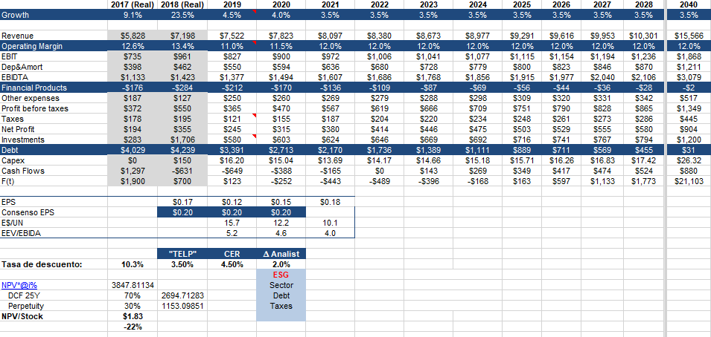
ESG ranking application to the discount rate

Slide 15
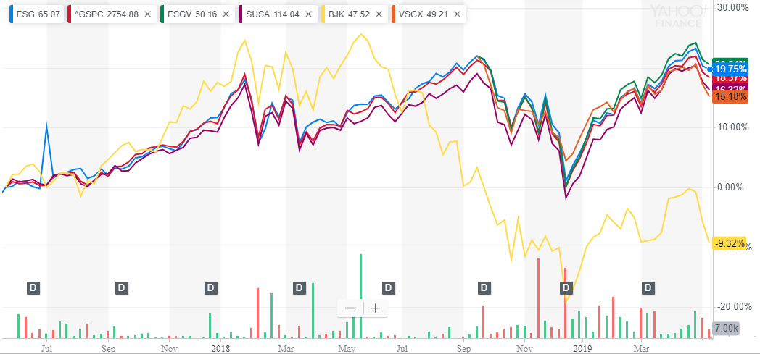
ESG Worldwide interesting data
  Morningstar: 16 of 20 ESG stock indexes outperform non-ESG
ESG (ESG Impact Index Fund), GSPC (SP500), ESGV (Vanguard ESG U.S. Stock ETF), SUSA (MSCI USA ESG Select), BJK (VanEck Vectors Gaming), VSGX (Vanguard ESG International Stock ETF) 3y graph
Source: Yahoo! Finance (last updated May 15th, 2019)

Slide 16
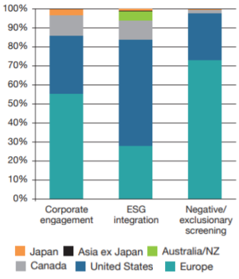
ESG Worldwide interesting data
  The most common funds, exclude companies, sectors, countries that lack ESG policies
  Main ESG factors searched
    Gender equality: Women in governing bodies
    Environment: Reduction of CO2 emissions
    Financing of renewable energies
The ESG investment has gained significant momentum in the last 3 years. Worldwide, in 2018 it reaches 23 trillion dollars (30% of the assets managed worldwide)
The incorporation of ESG factors has mainly been carried out in the US, followed by Europe and Canada.
Source: Global Sustainable Investment Review 2016, GSIA

Slide 17
Conclusions
It is a fact that the tendency is to move into socially responsible investments
It is not a minor issue to incorporate ESG in the investment process
It implies an important commitment of time and resources
If we want to do it well, we must give the importance it deserves, as well as respect the ESG result although we should not invest in something that we would have liked
It is a process of continuous education and updating
important to continue gaining experience, as well as to incorporate new methodology or ESG factors that add value to the analysis
Will allow us to know better in what we are investing, as well as a better risk management process

Slide 18

THANK Y U!
hislas@vitalis.com.mx

